Slide 1
Sky Socket
A Drone-Car Collaborative Project
Jonathan Schall, Demetrius Johnson,
Olivia Pellegrini, Ryan Sauer

Slide 2
TABLE OF CONTENTS
01
02
03
04
05
06
Project Needs/Objectives
Requirements and constraints
Design Tradeoffs
Prototyping/Testing
Results and Video
Live Demo

Slide 3
Project Needs/Objectives
The main deliverable for our client is a prototype for research on the concept of drone-car collaboration. In order to create a fully working prototype, we needed to fix and configure hardware, have the drone and car communicate with each other, detect events in the car’s path, and alert the car. More specifics are below:
Working drone and car
Visual detection of simulated events
Able to start and stop the car depending on detections
GUI to make ease of use easier
Collecting and recording necessary information

Slide 4
Requirements and Constraints
Requirements
Constraints
Fix drone so it may fly
Socket network between all devices
Car drive and stop controlled by event detection
Multi-Level object detection
Lightweight but limited level
Complex and more thorough level
GUI to assist in starting devices and to view drone view
Stuck with Clover drone and PiCAR-X
No backup hardware
Drone flight regulations limit where we can fly the drone
Limited time, and hardware delays and issues caused part of the project to start late

Slide 5
Design Tradeoffs
Object Detection
Kivy vs QT
Fast yet limited and inaccurate object detection is done on the drone using edge detection in OpenCV. This enables real time object detection at the source of the video, which only detects some objects.
A more robust and accurate level of detection is on an edge server (a laptop). It uses YOLOV4-tiny on darknet, and has been trained on over 1800 images. YOLOV4-tiny was chosen as it accurate enough while also working in real time
Qt has is a more robust and experienced UI framework. It’s also more flexible with prebuilt widgets.
However, our team had more experience working with Kivy. Since the project already consisted of enough unfamiliar material we chose to use Kivy

Slide 6
Prototyping/Testing
We performed black box unit testing on our hardware.
We performed white box unit testing on our software.
Integration testing was performed throughout the end of July and early August.
Functional testing was performed once all integration testing was done. We performed black box testing to ensure required functions were operational
Validation testing was performed in house along with our client to ensure it was up to standard and as requested.

Slide 7
Prototyping/Testing
UNIT TESTING STATUS
Total Number of Tests We Plan to Run | 123 |  | Current Test Completion Status (TotalTestsRan/totalNumTests) | 74.80%
Total Tests Ran | 92 |  | Current Test Completion Failure Rate (testsFailed/TotalTestsRan) | 1.09%
Total Tests Passed | 91 |  | Current Test Completion Pass Rate (testsPassed/TotalTestsRan) | 98.91%
Total Tests Failed | 1 |  | Overall Failure Rate (testsFailed/totalNumTests) | 0.81%
Failure-To-Success Ratio | 0.01 |  | Overall Pass Rate (testsPassed/totalNumTests) | 73.98% | GOAL = 100%
https://docs.google.com/spreadsheets/d/1nTfUQQfu9tRgcF2SL59ldLMxJKx71qvpQq1yz4_QAvk/edit?usp=sharing

Slide 8
Software and Hardware Context
Raspberry Pi model 4B
https://www.raspberrypi.com/products/raspberry-pi-4-model-b/
Used as the onboard computing device for both the car and the drone (each has their own Raspberry Pi computing device) for autonomous driving/flying by taking input from the sensors and processing the information, and also for communications (networking) with between devices (vehicles), such as wireless communications, i.e. WIFI.
Raspberry Pi Ai Car Kit (PiCar-X) for Intermediate
https://www.sunfounder.com/products/picar-x
https://docs.sunfounder.com/projects/picar-x/en/latest/introduction.html
Used as the physical device for the car including motors, frame, driving mechanism, and sensors.
The Raspberry Pi OS imager should be used to image the sd card that will serve as the nonvolatile memory unit the Raspberry Pi computer of the car:
https://www.raspberrypi.org/software/
Here is the Repository that is cloned onto the Raspbian OS image of the Raspberry Pi; it will contain all of the installation files needed to program and control the car:
https://github.com/sunfounder/robot-hat
Clover Drone 4.2
https://clover.coex.tech/en/
Used as the physical device for the drone including motors, frame, propellers, sensors, Electronic Speed Controllers (ESC), GPS, etc.
Includes Pixracer R15 Mini Pixracer Autopilot Xracer FMU V4 V1.0 PX4 Flight Controller
https://docs.px4.io/main/en/flight_controller/pixracer.html

Slide 9
Software and Hardware Context
Python Programming Language
https://www.python.org/
We will use the Python programming language for both the car and the drone.
OpenCV-Python Library
https://pypi.org/project/opencv-python/
This is a Python vision analysis library that has been adapted from a library originally written for C++
We will use it to analyze vision data collected from cameras on both the car and the drone.
Raspbian OS builds with Linux Kernel
https://www.kernel.org/
Both the car and the drone have their own onboard computing device (Raspberry Pi model 4B) with a custom modified version of the Raspbian Operating System image that uses the Linux Kernel.
Additionally, the Clover 4.2 Drone uses the ROS robotic framework used for advanced robotic distributed systems.
https://wiki.ros.org/
Here is the image used for the Clover 4.2 Drone Raspberry Pi computer:
https://github.com/CopterExpress/clover/releases/tag/v0.23
Image features:
Raspbian Buster
ROS Noetic
Configured networking
OpenCV
Mavros
Periphery drivers for ROS (GPIO, LED strip, etc)
Aruco_pose package for marker-assisted navigation
Clover package for autonomous drone control

Slide 10
Software and Hardware Context
Q Ground Control
https://docs.qgroundcontrol.com/master/en/
This is an open source software used to communicate with and calibrate and configure a drone’s flight controller firmware. We will use this to calibrate the drone and manage the flight controller’s parameters and how the flight system of the drone uses and responds to sensor data.
Here is the firmware image used for our flight controller:
https://github.com/CopterExpress/Firmware/releases/tag/v1.8.2-clover.13
Clover Drone Simulation virtual machine (VM) image
https://github.com/CopterExpress/clover_vm
This is the virtual machine image used to run the simulation software used to simulate programmed autonomous flights for the Clover 4.2 Drone.
Image contains:
Ubuntu 20.04 Focal.
ROS Noetic.
PX4 autopilot, QGroundControl.
Preinstalled Clover and Clover simulation packages.
Shortcuts for running Clover simulator.
VSCode.
Useful robotics-related software.
Drone Simulation Environment (Using Gazebo software)
The simulation environment is based on the following components: Gazebo, a state-of-the-art robotics simulator;
http://gazebosim.org/
PX4, specifically its SITL (software-in-the-loop) components;
https://px4.io/
sitl_gazebo package containing Gazebo plugins for PX4;
https://github.com/PX4/sitl_gazebo
ROS packages and Gazebo plugins
Note: all of the above components are installed on the Clover Drone Simulation VM in order to do simulation programming without the Raspberry Pi on board computing device of the drone. This allows for programming and simulation without needing the physical drone present.
Etcher - Flashing Software
https://www.balena.io/etcher
This is the software used to flash the micro-SD card with the respective OS (drone or car) used as the nonvolatile memory unit for the Raspberry Pi computers.

Slide 11
Software and Hardware Context
What is ROS (Robot Operating System)?
http://wiki.ros.org/
ROS (Robot Operating System) provides libraries and tools to help software developers create robot applications. It provides hardware abstraction, device drivers, libraries, visualizers, message-passing, package management, and more. ROS is licensed under an open source, BSD license.
MAVROS (package)
http://wiki.ros.org/mavros
MAVROS -- MAVLink extendable communication node for ROS with proxy for Ground Control Station.
This package provides a communication driver for various autopilots with MAVLink communication protocol. Additional it provides UDP MAVLink bridge for ground control stations (e.g. QGroundControl).
MAVLINK (package)
http://wiki.ros.org/mavlink?distro=noetic
MAVLink message marshaling library. This package provides C-headers and C++11 library for both 1.0 and 2.0 versions of protocol. For pymavlink use separate install via rosdep (python-pymavlink).
This package provides a communication library for various autopilot systems. This package contains both C-headers and pymavlink.
mavros_msgs/Mavlink Message
http://docs.ros.org/en/api/mavros_msgs/html/msg/Mavlink.html
The above link is the header file to the mavrov_msgs class which is used as a message transport class to convert between ROS and MAVLink message types.
Used to transport mavlink_message_t via ROS topic
Here is the documentation for the mavros_msgs class: http://docs.ros.org/en/api/mavros_msgs/html/index-msg.html
mavros_msgs defines messages for MAVROS
And here is another important class sensor_msgs: http://wiki.ros.org/sensor_msgs?distro=noetic
At least this package uses its own bundled (or installed by pip) mavlink headers or pymavlink: mavlink_ros, rospilot, roscopter, autopilot_bridge, px4-ros-pkg.
ros_core
Here is the documentation for ros_core class: http://wiki.ros.org/ros_core?distro=noetic
A metapackage to aggregate the packages required to use publish / subscribe, services, launch files, and other core ROS concepts.
libmavcon
http://wiki.ros.org/libmavconn?distro=noetic
MAVLink communication library. This library provide unified connection handling classes and URL to connection object mapper. This library can be used in standalone programs.
catkin library
http://wiki.ros.org/catkin?distro=noetic
Low-level build system macros and infrastructure for ROS.

Slide 12
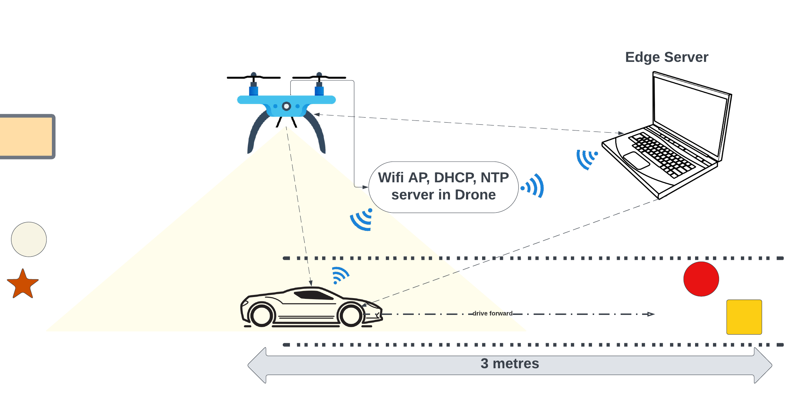
Prototyping/Testing

Slide 13
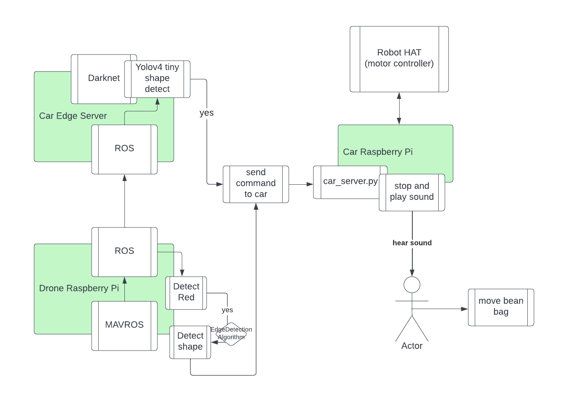
Prototyping/Testing

Slide 14
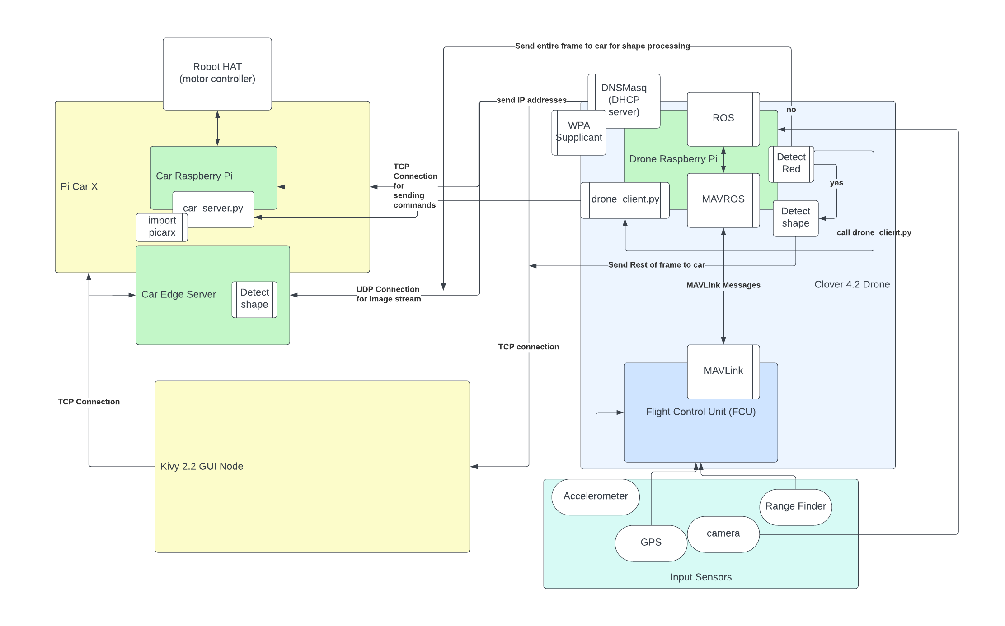
Prototyping/Testing

Slide 15
Project Results
Currently we are able to connect to the drone and car using our GUI and start both of their programs without sshing into them manually.
Once all of our command nodes are connected to the car command server, then the car will start driving.
The drone will publish video stream to two specific ROS topics that the edge server uses for running object detection, and also for viewing purposes for the experiment.
If the drone does not see a red object the frame will be offloaded to another ROS Topic used by the Edge Server to detect objects. When an object is detected the car will stop via stop commands it receives from edge server or drone, then start moving when there are no more objects (via all clear command it receives).
Did not get to some optional goals such as having the drone automatically following the car or attempting other communication methodologies

Slide 16
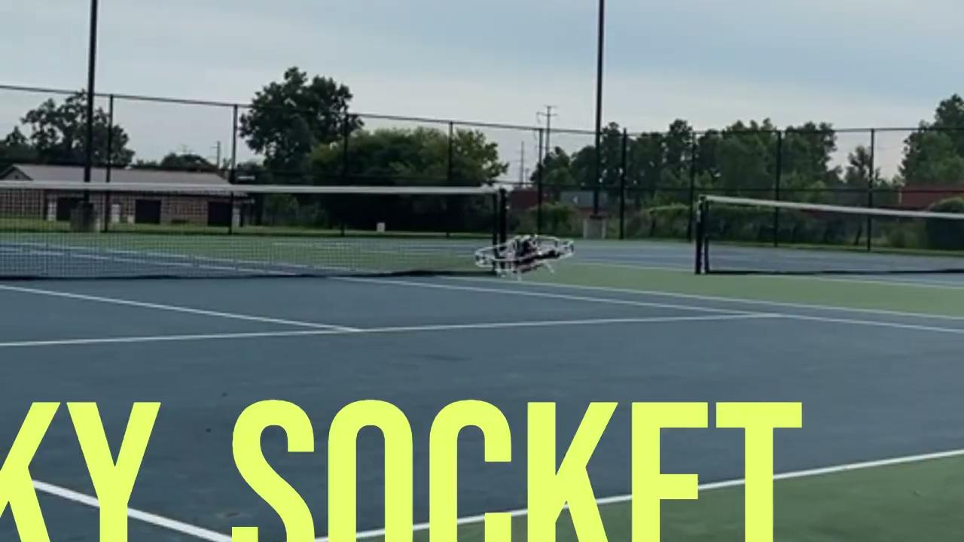
https://drive.google.com/file/d/1xSzB0w2ABLHQz2tyC2OFAtcbbkXKFnVK/view?usp=sharing

Slide 17
LIVE DEMO

Slide 18

Contact Us
Demetrius Johnson
meech@umich.edu
Ryan Saur
sauerr@umich.edu
Jonathan Schall
jcschal@umich.edu
Olivia Pellegrini
opelle@umich.edu
Dr. Zheng Song (Client)
zhesong@umich.edu
Dr. Bruce Maxim
Senior Design Professor/Director CIS-4952 Winter 2023
bmaxim@umich.edu

Slide 19
Research References
S. A. Hadiwardoyo, E. Hernández-Orallo, C. T. Calafate, J. -C. Cano and P. Manzoni, "Evaluating UAV-to-Car Communications Performance: Testbed Experiments," 2018 IEEE 32nd International Conference on Advanced Information Networking and Applications (AINA), Krakow, Poland, 2018, pp. 86-92, doi: 10.1109/AINA.2018.00025.
URL: https://ieeexplore.ieee.org/stamp/stamp.jsp?tp=&arnumber=8432227&isnumber=8432202
J. Yoon, I. Kim, W. Chung and D. Kim, "Fast and accurate car detection in drone-view," 2016 IEEE International Conference on Consumer Electronics-Asia (ICCE-Asia), Seoul, Korea (South), 2016, pp. 1-3, doi: 10.1109/ICCE-Asia.2016.7804775.
URL: https://ieeexplore.ieee.org/stamp/stamp.jsp?tp=&arnumber=7804775&isnumber=7804716
Yildiz, Melih, Burcu Bilgiç, Utku Kale, and Dániel Rohács. 2021. "Experimental Investigation of Communication Performance of Drones Used for Autonomous Car Track Tests" Sustainability 13, no. 10: 5602.
URL:
https://doi.org/10.3390/su13105602
Barbeau, Michel, Joaquin Garcia-Alfaro, and Evangelos Kranakis. 2022. "Research Trends in Collaborative Drones" Sensors 22, no. 9: 3321.
URL:
https://doi.org/10.3390/s22093321
Textbook: Software Engineering A PRACTITIONER'S APPROACH EIGHTH EDITION, by Roger S. Pressman, Ph.D. and Bruce R. Maxim, Ph.D.
Notes:
meech

